Slide 1
Introduction to Psychology
Saba Abid

Slide 2
Objectives:
To be able to understand:
The concept of PSYCHOLOGY
A brief introduction to PSYCHOLOGY
Why psychology is a science
Career paths in Psychology
Brief history of Psychology

Slide 3
Psychology

Slide 4
Psychology
The word ‘Psychology’ comes from GREEK words:
‘Psyche’ meaning SOUL or MIND
‘Logos’ meaning EXPLANATION, STUDY

Slide 5
Definition of Psychology
Psychology is the scientific study of mind and behavior.
Why MIND?
Why BEHAVIOR?
Why SCIENTIFIC?

Slide 6
Why MIND?
Mind controls all your mental processes.
Mental processes include?
Why BEHAVIOR?
Mental processes cannot be seen directly, you can only observe them through BEHAVIOR
Behavior
Any response or activity of an organism. It can either be simple or complex; overt or covert; conscious or unconscious; voluntary or involuntary; rational or irrational.

Slide 7
Psychology as a Science
The Problem of Intuition
WHAT IS INTUITION?

Slide 8
What is intuition?
Intuition is a feeling or thought you have about something without knowing why you feel that way.
It’s a function of the unconscious mind — those parts of your brain / mind (the majority of it, in fact) that you don’t consciously control or perceive.
It’s an instinctual response to a situation that allows one to make the right decision without the need for analytical reasoning.
It’s synonymous with “gut feeling.”
Intuition is thinking that is more experiential, emotional, automatic, and unconscious, and does not lead to careful analysis of all the variables in a situation (Kahneman, 2011).

Slide 9
You: What should I wear today? Your Unconscious: Red. You: Why? Your Unconscious: Feels good. You: But I have an interview today; isn't red too aggressive? Your Unconscious: You're missing the point. You: What's the point? Your Unconscious: You like red. It makes you feel happy. You: What has happiness got to do with this? Your Unconscious: Everything. You: How? Your Unconscious: You'll see; just trust me on this.

Slide 10
And perhaps in doing this, because you simply feel good, you exude more confidence at your interview, and you receive the job based on this. Perhaps your interviewer loves red, and enjoys that you were bold enough to not wear black. Perhaps the color is what makes you stand out from so many others. Who knows? The point is, you listened to your instincts and made your decision, including intuition and benefitting from it, without worrying about the logical reasons why.

Slide 11
Example of intuition
What kind of society do you want to live in?
Some people want to live in a society of constant competition, believing that this allows the “best” individuals to rise to the top, which is better for everyone. Others have the intuition that this sort of competition always favors those with unearned advantages such as inherited wealth, good looks, or sheer luck in business. There may be no objective basis for testing one intuition against the other; it may just be a question of what you value.

Slide 12
Why SCIENTIFIC?
Psychology is a science because psychologists are empirical, which means they are based on systematic collection and analysis of data.
The scientific method is the set of assumptions, rules, and procedures scientists use to conduct research.
The scientific method demands that the procedures used are objective, or free from the personal bias or emotions of the scientist.
The scientific method describes how scientists collect, analyze, draw conclusions from, and share data.

Slide 13
CAREER PATHS IN PSYCHOLOGY
Fields | Discription
Clinical Psychology | Clinical psychology is a broad branch of psychology that focuses on diagnosing and treating mental, emotional, and behavioral disorders.
Counseling Psychology | Counseling Psychology is a specialty within professional psychology that maintains a focus on facilitating personal and interpersonal functioning across the life span.
Educational Psychology | Educational psychology is devoted to the study of how humans learn in educational settings.
Organizational Psychology OR Industrial and organizational psychology | Industrial-organizational psychology applies psychology to the workplace with the goal of improving the performance and well-being of employees.
Forensic Psychology | Forensic psychologists apply psychological principles to understand the behavior of judges, attorneys, courtroom juries, and others in the criminal justice system.
Media Psychology | Media psychology is branch of psychology that focuses on the relationships between media and human behavior.
Architecture Psychology | Architecture psychology deals with the application of psychology in the field of architecture.

Slide 14
History of Psychology
Perspectives | Description
Structuralism | A school of psychology whose goal was to identify the basic elements or “structures” of psychological experience.
Functionalism | Psychology should study the functions of consciousness rather than its structure. The goal of functionalism was to understand why animals and humans have developed the mental processes that they currently possess .
Psychodynamics | This school of thought emphasizes the influence of the unconscious mind and early childhood experiences on behavior.
Behaviorism | Behaviorism suggests that all behavior can be explained by environmental causes rather than by internal forces.
Humanistic | Humanistic psychology focuses on individual free will, personal growth and the concept of self-actualization.
Cognitive | Cognitive psychology is the branch of psychology that studies mental processes including how people think, perceive, remember, and learn.
Biological | The biological perspective focuses on the interaction between biology and emotions, thoughts, and behaviors.
Social-cultural | Social-cultural or sociocultural perspective, is the study of how the social situations and the cultures in which people find themselves influence thinking and behavior.

Slide 15
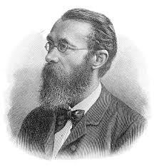
Structuralism
Wilhelm Wundt (1832-1920)
Structuralism was the ﬁrst school of psychology, and focused on breaking down mental processes into the most basic components.
It is focus on studying the building blocks/structure of the mind.
Mind: Conscious experience
A school of psychology whose goal was to identify the basic elements or “structures” of psychological experience.

Slide 16
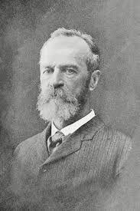
Functionalism
Functionalism formed as a reaction William James to the theories of the structuralist school of thought.
Psychology should study the functions of consciousness rather than its structure.
The goal of functionalism was to understand why animals and humans have developed the mental processes that they currently possess .
Defines behavior or the mental phenomena in terms of their functions in man’s adjustment to his environment.
William James (1842-1910)

Slide 17
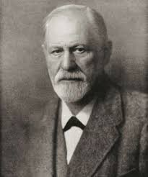
Psychodynamic
Sigmund Freud (1856–1939)
This school of thought emphasizes the influence of the unconscious mind and early childhood experiences on behavior.
Freud believed that the human mind was composed of three elements:
The Id
The Ego
The Superego
Freud believed that the interaction of these three elements was what led to all of the complex human behaviors

Slide 18
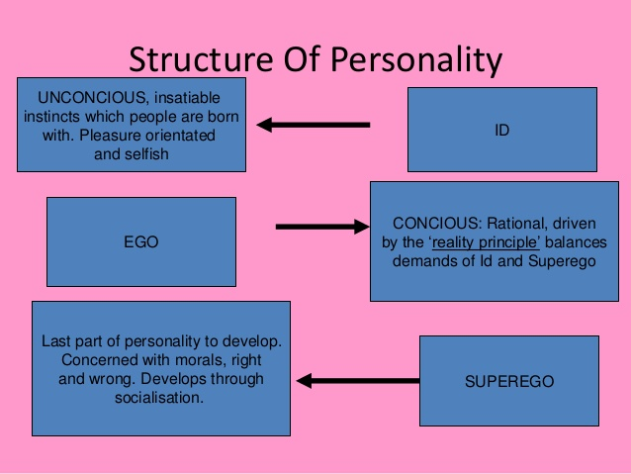

Slide 19
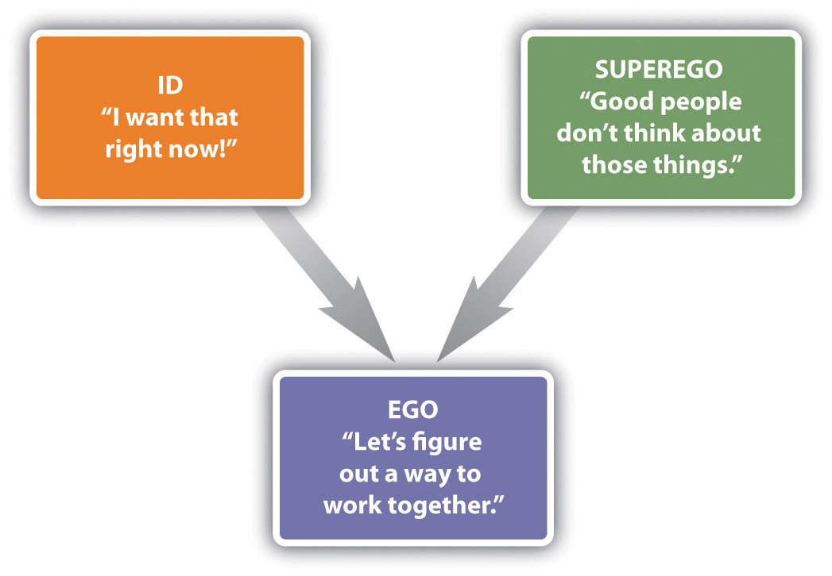

Slide 20
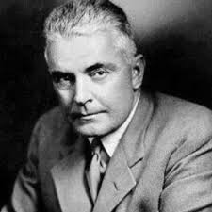
Behaviorism
John B. Watson (1878-1958)
Behaviorism is based on the premise that it is not possible to objectively study the mind, and therefore psychologists should limit their attention to the study of behavior itself.
Behaviorism suggests that all behavior can be explained by environmental causes rather than by internal forces.
Behaviorism is focused on observable behavior.

Slide 21
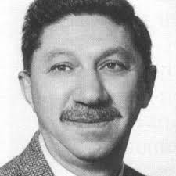
Humanistic
Abraham Maslow (1908 –1970)
Humanistic psychology developed as a response to psychoanalysis and behaviorism.
Humanistic psychology focuses on individual free will, personal growth and the concept of self-actualization.
While early schools of thought were primarily centered on abnormal human behavior, humanistic psychology differed considerably in its emphasis on helping people achieve and fulfill their potential.
The humanistic perspective believes that individuals possess personal choice and can rise above the unconscious desires suggested by Freud and his followers.

Slide 22
Biological Perspective
The biological perspective focuses on the interaction between biology and emotions, thoughts, and behaviors.
Some researchers from the biological perspective might examine the role of genes in influencing our personality, intelligence, or tendency to develop psychological disorders.

Slide 23
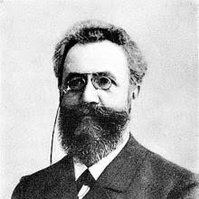
Cognitive Perspective
Hermann Ebbinghaus (1850–1909)
Cognitive psychology is the branch of psychology that studies mental processes including how people think, perceive, remember, and learn.
The cognitive perspective examines the nature of mind and how mental processes influence behavior.
The Cognitive perspective studies mental processes, including perception, thinking, memory, and judgment.

Slide 24
Social-Cultural Perspective
Social-cultural or sociocultural perspective, is the study of how the social situations and the cultures in which people find themselves influence thinking and behavior.
Emphasizes social interactions and cultural determinants of behavior and mental processes
Focus is on ethnicity, religion, occupation and socioeconomic class and how
these contribute to behavior.
Allows us to understand how society and culture influence our behavior and
mental processes

Slide 25
QUESTIONS?

